Slide 1
Chapter 30
Message Security,
User Authentication,
and Key Management

Slide 2
30.1 Message Security
Privacy
Authentication
Integrity
Nonrepudiation

Slide 3
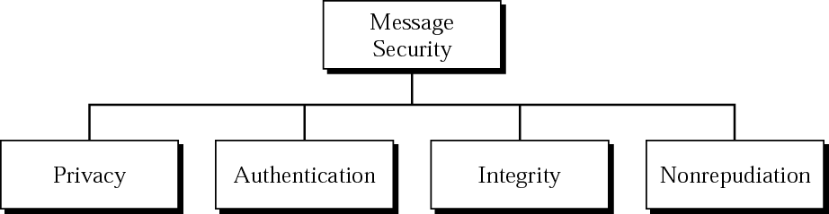
Figure 30.1 Message security

Slide 4
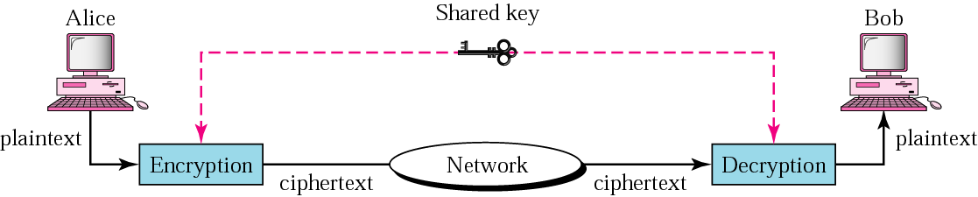
Figure 30.2 Privacy using symmetric-key encryption

Slide 5
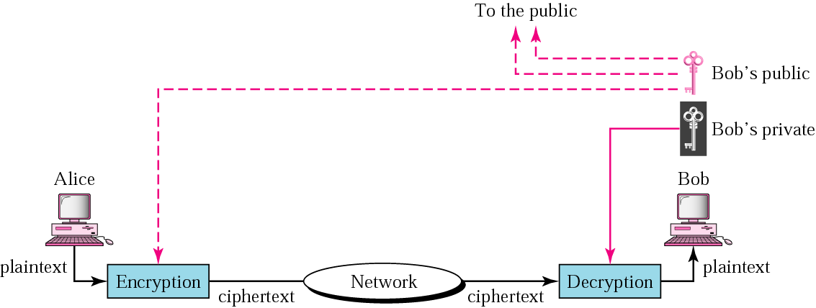
Figure 30.3 Privacy using public-key encryption

Slide 6
30.2 Digital Signature
Signing the Whole Document
Signing the Digest

Slide 7
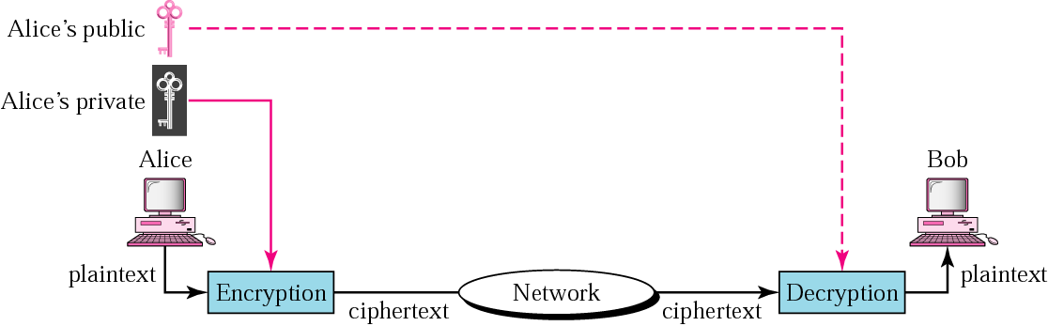
Figure 30.4 Signing the whole document

Slide 8

Note:
Digital signature does not provide privacy. If there is a need for privacy, another layer of encryption/decryption must be applied.

Slide 9
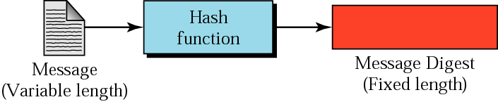
Figure 30.5 Signing the digest

Slide 10
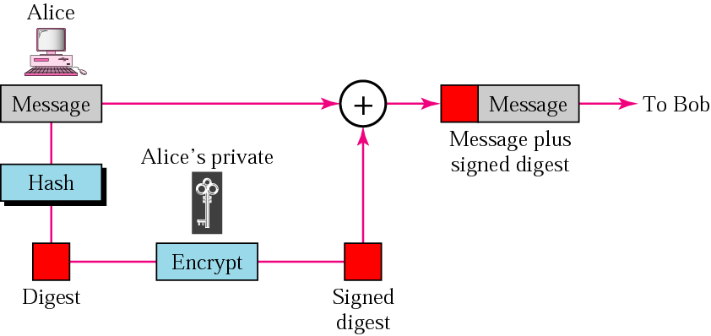
Figure 30.6 Sender site

Slide 11
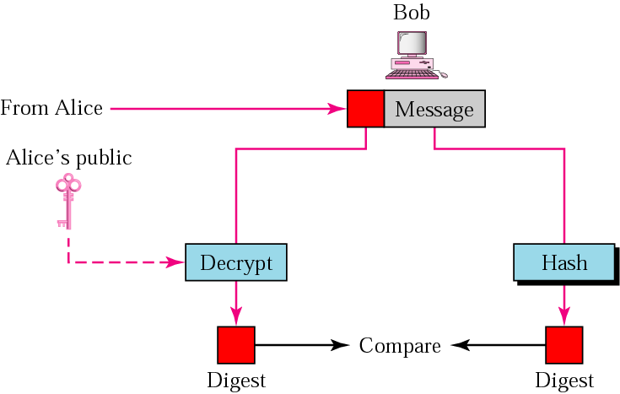
Figure 30.7 Receiver site

Slide 12
30.3 User Authentication
With Symmetric Key
With Public Key

Slide 13
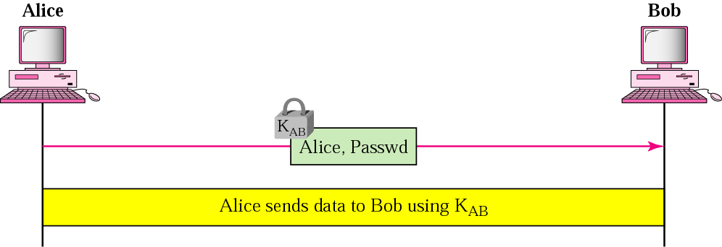
Figure 30.8 Using a symmetric key only

Slide 14
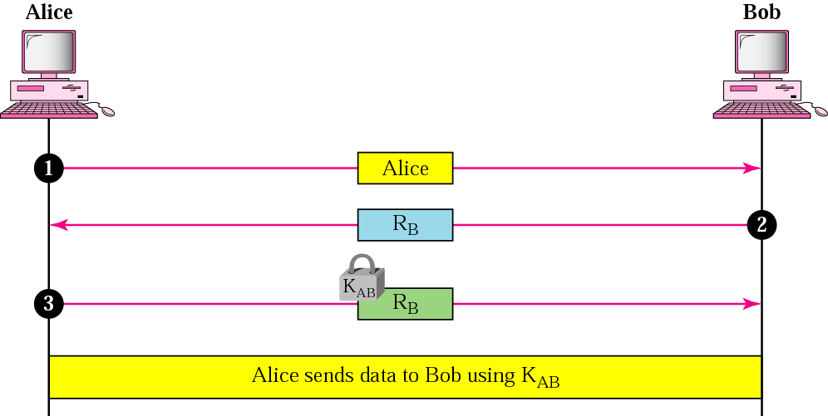
Figure 30.9 Using a nonce

Slide 15
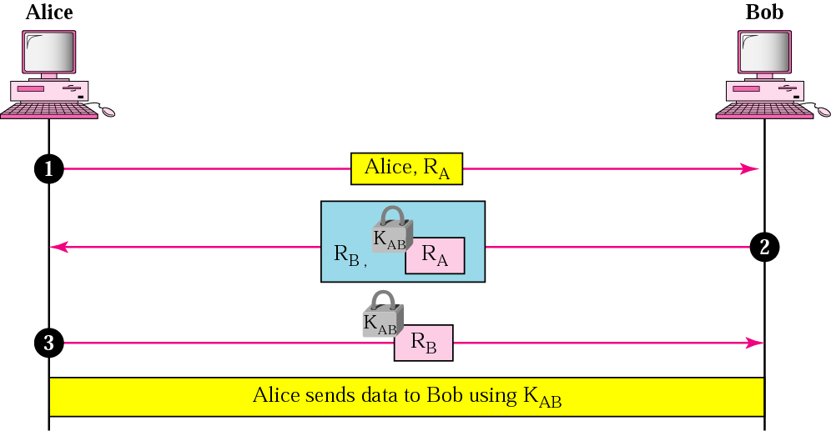
Figure 30.10 Bidirectional authentication

Slide 16
30.4 Key Management
Symmetric-Key Distribution
Public-Key Certification

Slide 17
Note:
A symmetric key between two parties is useful if it is used only once; it must be created for one session and destroyed when the session is over.

Slide 18
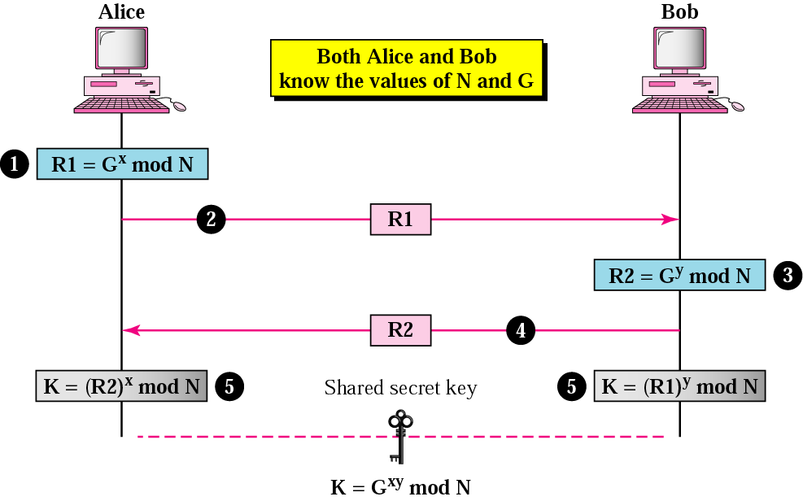
Figure 30.11 Diffie-Hellman method

Slide 19
Note:
The symmetric (shared) key in the Diffie-Hellman protocol is
K = G^{xy} mod N.

Slide 20
Example 2
Assume G = 7 and N = 23. The steps are as follows:
1. Alice chooses x = 3 and calculates R1 = 7³ mod 23 = 21.
2. Alice sends the number 21 to Bob.
3. Bob chooses y = 6 and calculates R2 = 7⁶ mod 23 = 4.
4. Bob sends the number 4 to Alice.
5. Alice calculates the symmetric key K = 4³ mod 23 = 18.
6. Bob calculates the symmetric key K = 21⁶ mod 23 = 18.
The value of K is the same for both Alice and Bob;
G^{xy} mod N = 7¹⁸ mod 23 = 18.

Slide 21
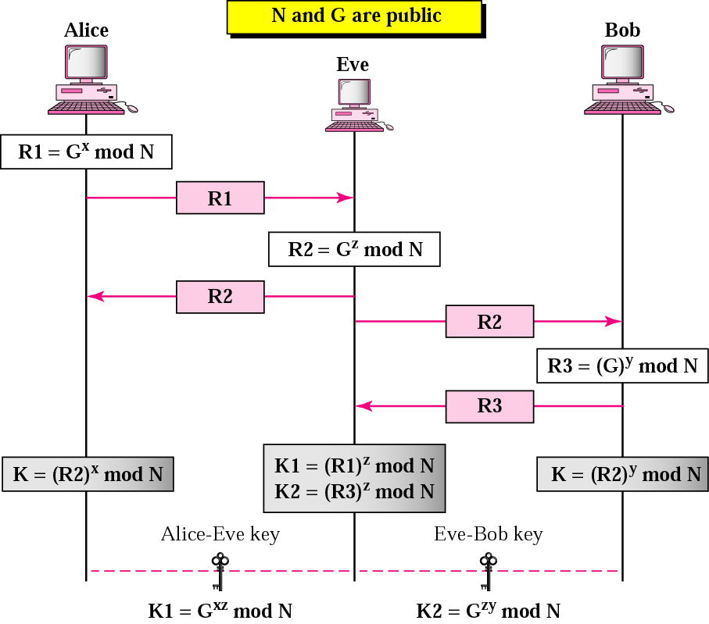
Figure 30.12 Man-in-the-middle attack

Slide 22
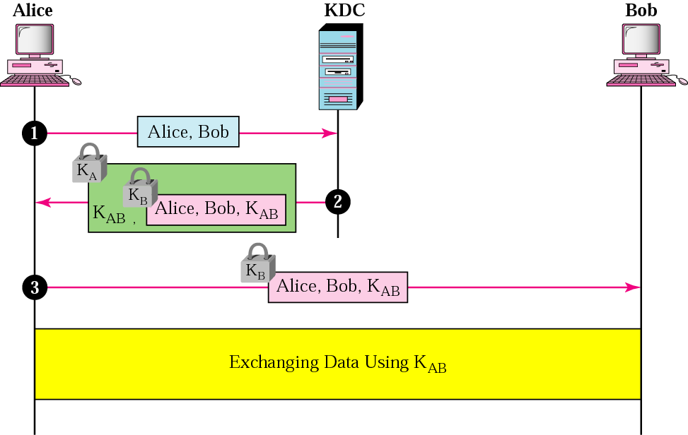
Figure 30.13 First approach using KDC

Slide 23
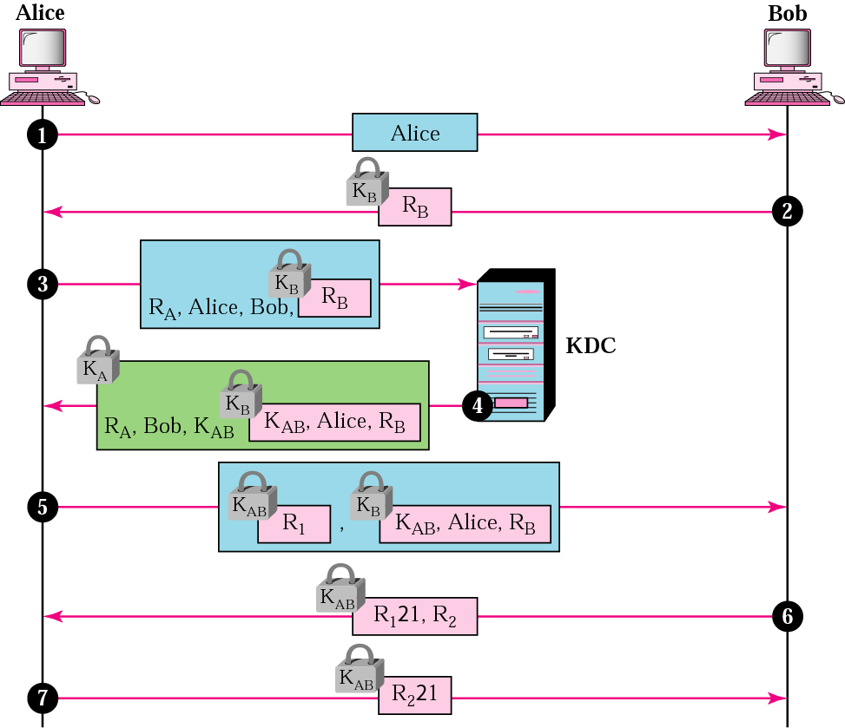
Figure 30.14 Needham-Schroeder protocol

Slide 24
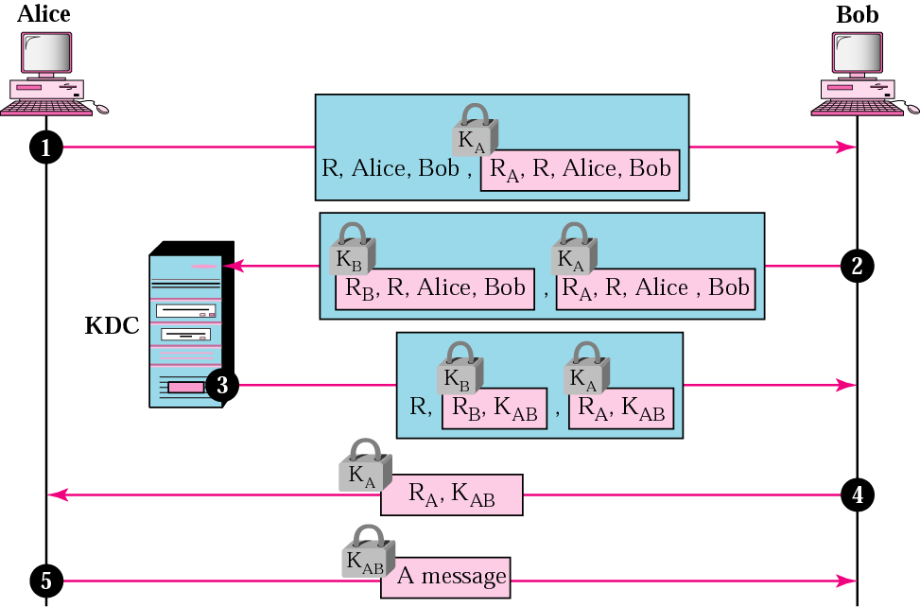
Figure 30.15 Otway-Rees protocol

Slide 25
Note:
In public-key cryptography, everyone has access to everyone’s public key.

Slide 26
Table 30.1 X.500 fields
Field | Explanation
Version | Version number of X.509
Serial number | The unique identifier used by the CA
Signature | The certificate signature
Issuer | The name of the CA defined by X.509
Validity period | Start and end period that certificate is valid
Subject name | The entity whose public key is being certified
Public key | The subject public key and the algorithms that use it

Slide 27
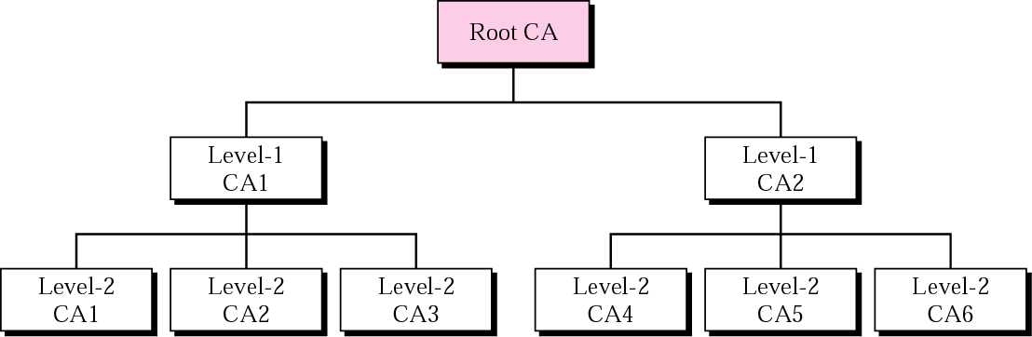
Figure 30.16 PKI hierarchy

Slide 28
30.5 Kerberos
Servers
Operation
Using Different Servers
Version 5
Realms

Slide 29
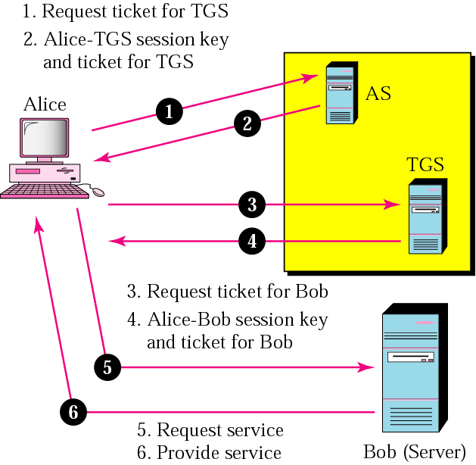
Figure 30.17 Kerberos servers

Slide 30
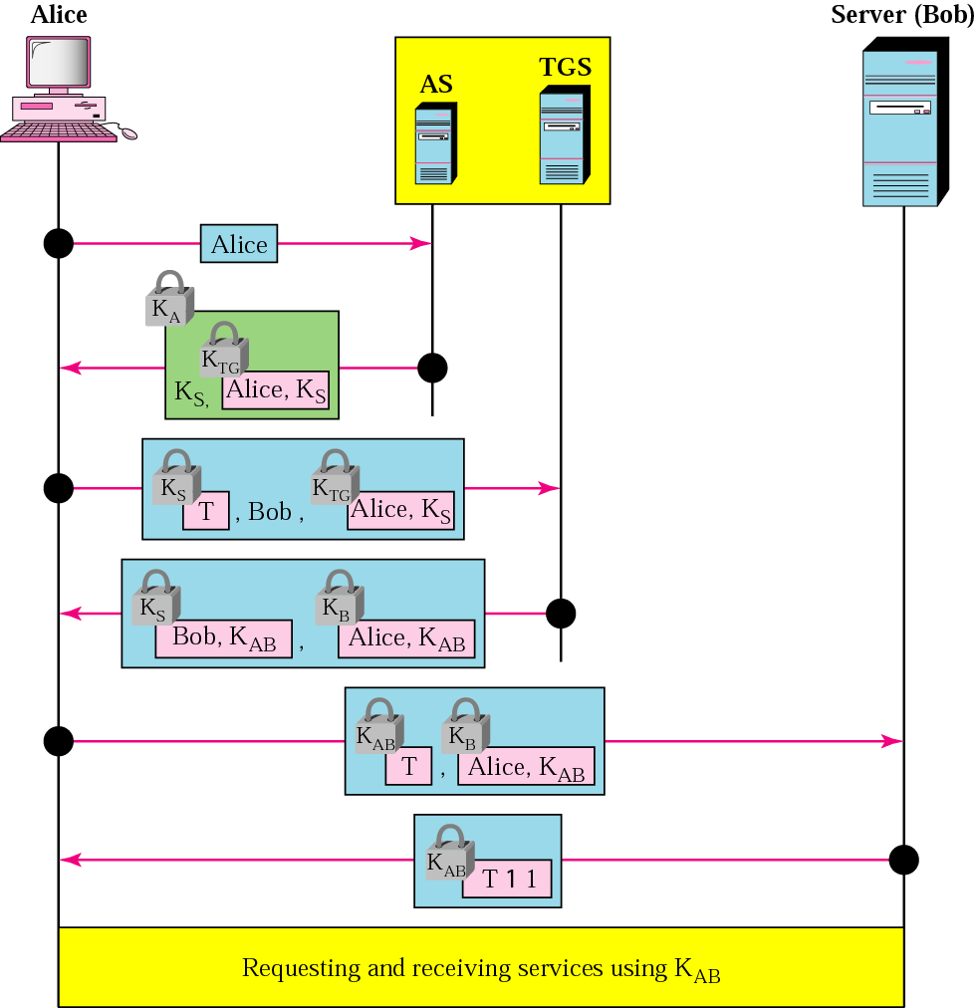
Figure 30.18 Kerberos example

